Slide 1
DISD Booster Club Workshop
Presented by Denton ISD:
Vicki Garcia, Executive Director
Julie Simpson, Financial Director
Sharon Harris, General Accountant
Chris Bomberger, Executive Director
Kim Smith, Risk Management
Adriane Cruz, Risk Management

Slide 2
Disclaimer
We understand you may hear things today that you may not have heard before.
It is the intention of the District that the information provided today will assist each Booster Club with implementing the best practices being discussed.
Specific UIL questions will be recorded and submitted to the Athletics and Fine Arts Department for answers.
Notes:
That each Booster Club to implement the best practices being discussed today.
The information presented today
Please take this information and begin incorporating it in your Booster Club.

Slide 3
Working with a school district
Law- Things we do because it falls under TEA, UIL, TDA, GASB, IRS and Federal and State Government *
Policy – Things we do because of School Board Policy
Practice – Things we do to implement the Law and Policy.
Additionally, district practices may be more restrictive to support and protect our students and assets.
*TEA – Texas Education Agency / TDA – Texas Department of Agriculture / GASB – Government Accounting Standards Board

Slide 4
Overview of today’s training:
General UIL Guidelines
Denton ISD PTA/Booster Club Information Guide Highlights
Denton ISD Board Policy
Denton ISD/Booster Club Relationships
Risk Management Department
Bylaws Template

Slide 5
General Uil guidelines

Slide 6
Athletic Booster Clubs
UIL Constitution and Contest Rules
Athletic Amateur Rule – Section 441
Awards Rule – Section 480
Funds shall not support athletic camps, clinics, private instruction, or any activity outside of the school.
School must give prior approval for any banquet or get-together given for students.
Students may not accept money or other valuable consideration from school booster club funds for any non-school purpose.
May donate money or merchandise to school with prior approval of the administration.
Notes:
Examples: Cover cost of commercial transportation /assets costing greater than $4,999

Slide 7
Academic Booster Clubs
Amateur rule does not apply to Academic Booster Clubs
Academic students are restricted by the awards rule (UIL Constitution and Contest Rules – Section 480)
Booster Clubs should not give gifts or award to students for their participation in UIL Contests
Booster Club can donate funds to the campus student group to be used at the discretion of the student group sponsor and principal
Booster Clubs may raise money to support the Academic students
Notes:
Examples: annual banquet / raise money for scholarships

Slide 8
Music Booster Clubs
Amateur rule does not apply to Music Booster Clubs
Music students are restricted by the awards rule (UIL Constitution and Contest Rules – Section 480)
Booster Club can donate funds to the campus student group to be used at the discretion of the student group sponsor and principal
Booster Clubs may raise money to support the Music students
Notes:
Examples: educational trips / patches

Slide 9
Denton I.S.D. PTA/Booster Club Information Guide Highlights
PTA/Booster Club Information Guide
Click Path:
Denton ISD Website => Our District => Business => Booster Club & PTA Information => Denton ISD PTA/Booster Club Information Guide

Slide 10
Guideline Overview
DISD Contacts
General Resources

Slide 11
Booster Clubs Shall
Comply with DISD Policies, UIL Regulations, and Federal and Texas State Tax Laws.
Have established bylaws to ensure stability, help resolve conflict, define processes and provide a roadmap for future officers.
Keep minutes of meetings and audited (either by committee or independent auditor) financial reports for required retention period.
Provide evidence of adequate insurance coverage for activities conducted on school premises.
Have campus principal or designee approve all fundraisers.
Pay all taxes and other debts incurred by the Booster Club.
Elect officers by member vote.

Slide 12
Booster Clubs Shall Not
Use school facilities without prior written approval from campus principal or Executive Director of Operations.
Establish a “petty cash” or “miscellaneous funds” account for the district staff to use at their discretion.
Give gifts or cash in excess of the limits imposed by the UIL.
Be permitted to collect student fees for items required for participation in a campus activity.
Directly employ, contract, supplement or in any other way compensate a consultant, clinician, accompanist or paraprofessional for work performed for the student activity.
Sign contracts for student travel associated with the campus, student group or organization.
Pay expenses directly to the vendor from the Booster Club bank account for student travel associated with the campus, student group or organization.
Use Denton ISD tax identification number.
Use Denton ISD tax exemption form when making purchases from the Booster Club bank account.

Slide 13
Booster Club Best Practices
Do not use Booster Club funds to support any non-school activities.
Booster club officers must have a child active in the program.
A member without a child active in the program shall not handle money.
Provide meeting minutes and financial reports to the campus / district activity sponsor.
Annually provide a list of board officers and contact information to the activity sponsor and campus administrator.
Booster Club bylaws should contain a dissolution statement such as:
“Upon dissolution of the Club or the winding up of its affairs, the assets of the club shall be distributed exclusively to the program activity fund at the designated campus.”

Slide 14
Denton ISD Board Policy

Slide 15
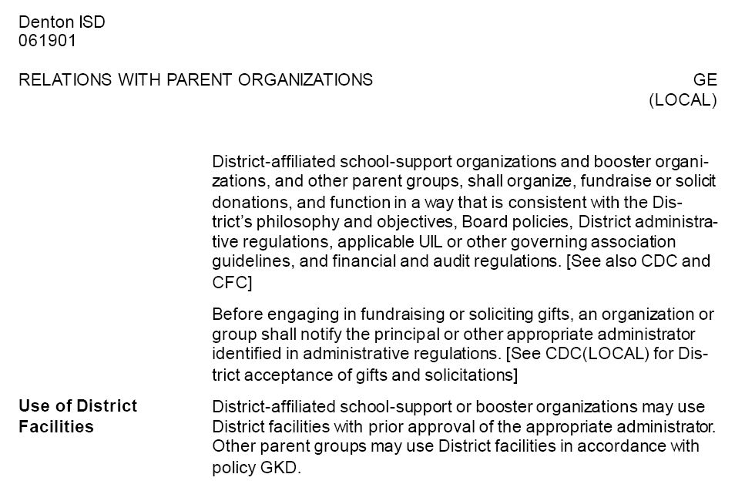
Denton ISD Board Policy – GE (Local)

Slide 16
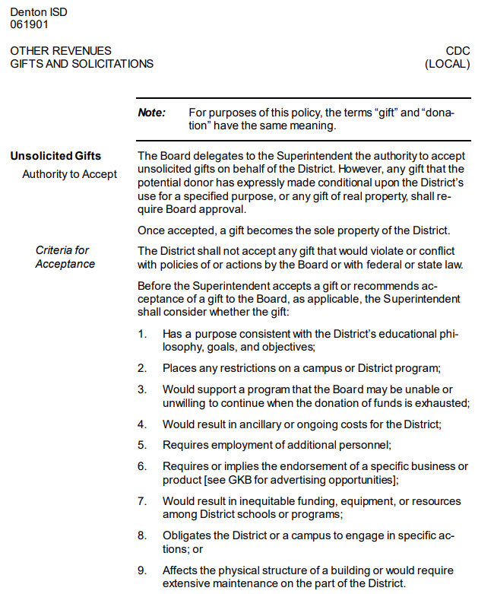
Denton ISD Board Policy – CDC (Local) – Excerpt from policy

Slide 17
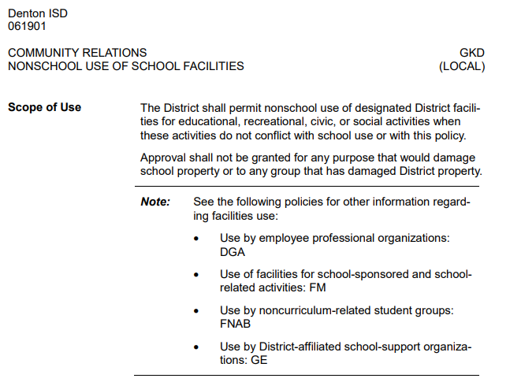
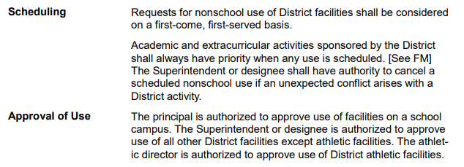
Denton ISD Board Policy – GKD (Local) – Excerpt from policy

Slide 18
Denton I.S.D./Booster Club relationships

Slide 19
Booster Club organizations may be formed to promote the school program or to compliment a particular student group or activity.
Students enrich their education and expand their horizons when they participate in school activities and programs.
The District greatly appreciates the time, effort and financial support that the Booster Clubs provide to our students.
Even though a Booster Club works very closely with the District, it is a separate entity from the District.
However, the formation of a Booster Club must be approved by the appropriate District Principal or Administrator.
In addition, a Booster Club must abide by all Denton ISD policies, University Interscholastic League (UIL) regulations, Federal laws and Texas State laws concerning Booster organizations.

Slide 20
We are all
“puzzle pieces”
in our support of
the student groups within Denton ISD
Superintendent of Schools
Principal
Booster Clubs
Sponsor
Notes:
Add to sponsor notes-booster clubs should not have an account set aside for sponsor discretionary use

Slide 21
Superintendent of School
Solely responsible for the entire educational program including curricular and extracurricular activities.
All activities, events, and personnel are under the jurisdiction of the Superintendent.

Slide 22
principal
Directly responsible for all activities at the campus, including activities to raise money.
Planning special programs and activities are to be organized in full cooperation with the Principal.

Slide 23
sponsor
Serves as the liaison between the Booster Club and the District.
Supervised by the Principal.
Responsible for determining the various activities and trips in which the student group will participate
Must be approved by the Principal and Area Superintendent.
Booster Clubs should not have an account set aside for sponsor discretionary use

Slide 24
Booster Club
Responsible for supporting student group, activity, or program.
Examples:
fan support at games or events
raising money to supplement an event
purchase props, meals, supplies
monetary support for student travel must be donated funds to the school
Booster Clubs shall not pay a vendor directly for travel
Fundraisers sponsored by the Booster Club shall identify the Booster Club name as the recipient of the funds for complete transparency
If needed, provides assistance for the planned activities of the student group.
Does not have authority to decide the activities or trips in which the student group will participate.

Slide 25
Student
Groups
Supported
Notes:
Add to sponsor notes-booster clubs should not have an account set aside for sponsor discretionary use

Slide 26
DISTRICT OR BOOSTER CLUB
EVENT
Question: “Is this event a Booster Club or Campus/Student Club event?”
The determining factor of who owns an event is “Who has the decision authority of the event”
Monetary support alone is not the deciding factor. A Booster Club may provide financial support for a campus or student club event, but they have no decision authority to decide the activity or trips in which the campus or student club participate.

Slide 27
DISTRICT OR BOOSTER CLUB
EVENT
District
School has the decision authority over the event
Students may be required to participate
Student fees may be collected in relation to the event
Example: Student group trip
Example: Competition participation
Booster Club
Booster Club has the decision authority over the event
Example: Fundraising booth at campus carnival or festival
Example: Booster Club Fundraisers – carwash, t-shirt sales, etc

Slide 28
Risk Management Department
Chris Bomberger, Executive Director of Risk Management/CN/Benefits
Kim Smith, Coordinator of Risk Management and Benefits
Adriane Cruz, Admin Assistant, Executive Director

Slide 29
Risk Management
Booster Clubs and/or PTA On Campus Events Sponsored by Denton ISD
Any inflatable, obstacle courses, slides, mechanical bulls, and bounce houses, contracted must have the campus name, followed with Booster Club and/or PTA (example: Bell ES PTA) and all fees must be paid for by Booster Club or PTA.
As directed by Denton ISD Board Policy GKD (LOCAL), PTA/Booster Clubs are responsible for providing evidence of adequate insurance coverage for activities conducted on school premises.
Example of Certificate of Insurance can be found by Click Here

Slide 30
RISK MANAGEMENT
Campus Activities or Programs with Campus Principal Approval:
All Other On Campus Events
All Other Activities Requirements: Click Here
Requirements:
DISD Booster Club & PTA Contract Agreement (download document) Click Here
Must include supporting documentation (invoice, emails, and other information pertaining to the event)
Booster Club/PTA member must sign prior to forwarding all information to the Campus Principal for signature
Campus will forward to the Area Superintendents office for signature.
Area Superintendents will forward to Risk Management
Campus will receive signed documents from Sherry Arrington

Slide 31
Risk Management
Campus Activities or Programs with Campus Principal Approval:
Bounce House/Inflatable Requirements
Contracts pertaining to inflatables and bounce houses must have the campus name followed by Booster Club and /or PTA (example: Bell ES PTA) and must be paid with Booster Club or PTA funds.
Bounce houses must be on the Risk Management Booster Club/PTA – Authorized Bounce House/Inflatable Vendors listing Click Here
Should a Bounce House vendor not appear on the “PTA/Booster Clubs Application Request for Vendor Authorization,” the vendor will then need to complete the Google form Click Here
Bounce House vendors must appear on the following two websites to be approved:
Texas Dept of Ins - Amusement Ride Stickers
Texas Dept of Ins - Amusement Ride Current Insurance Policies
Questions regarding contracts, vendor authorization, or insurance certificates please contract: Risk Management @ 940-369-0023 or email riskmanagement@dentonisd.org

Slide 32
Booster Club Bylaws template

Slide 33
Sample Bylaws Template
Band
Choir

Slide 34
Questions
FAQs from today’s training will be posted on the DISD Business Office “Booster Club & PTA Guidelines” webpage, along with a copy of this presentation.

